Slide 1
Quadruped Gait Learning
Design of Control System for Quadruped using Central Pattern Generators
Shreyas Shandilya

Slide 2
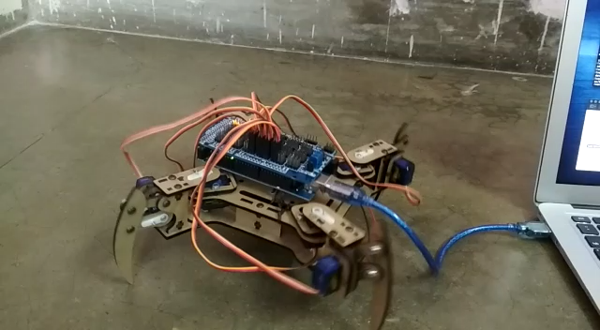
Robot walking Video
Observe the tendency of the robot to topple towards the swinging leg
Notes:
My work has been largely interdisciplinary, spanning the development of the hardware and the software, that is the neural network for driving the quadruped. So far I have been able to get the quadruped to walk at a constant speed using a prototype neural network architecture. The objective of the project is to develop a neural network emulating the sensorimotor processing in animals to allow the quadruped autonomous wandering in any environment

Slide 3
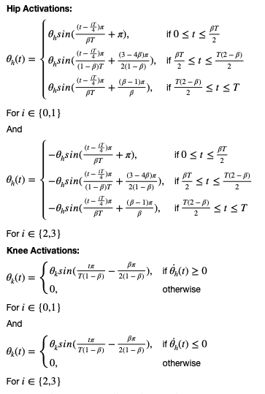
Gait Pattern
Pattern in use and problems with it
This Gait Pattern obtained from the formulation in the figure is for a creep walk of the quadruped
The robot walks with this Gait Pattern
But the stability of the quadruped is not maintained
The quadruped tends to topple towards the leg in swing phase
Notes:
The Prototype NN as trained using supervised learning and the data used for training was an assumed ideal gait pattern, formulated by a combination of sinusiodals shown here. However, the walk from this pattern lacks stability and needs improvement

Slide 4
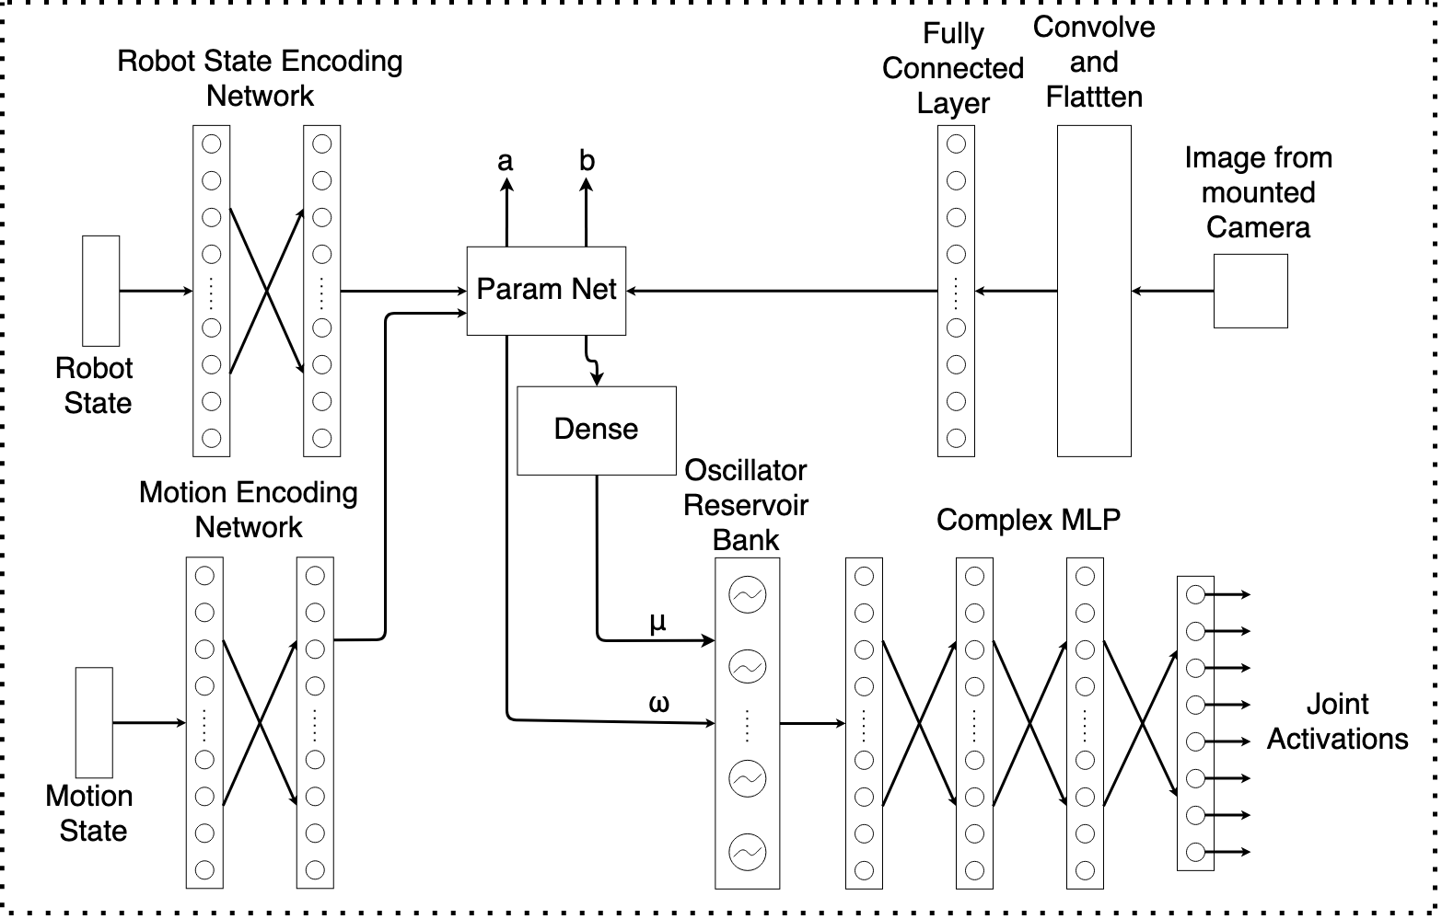
Architecture
Notes:
The Network has a modular architecture. The Oscillators and the Complex MLP are responsible for joint activation, whereas the rest of the modules are responsible for gait modulation.The Motion Encoding network ensures modulation in response to a higher lever input like remote control, the robot state encoding network ensures stability of motion and the CNN here will be used for obstacle avoidance.

Slide 5
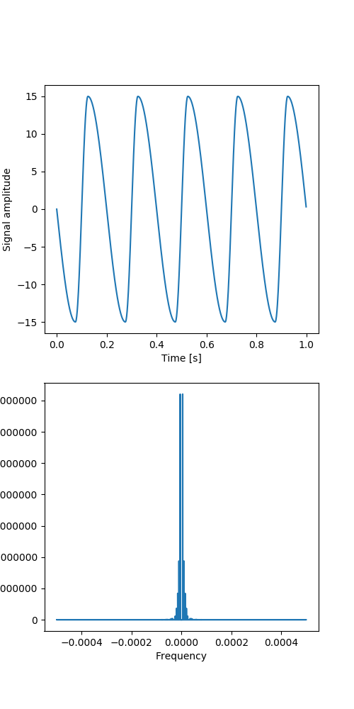
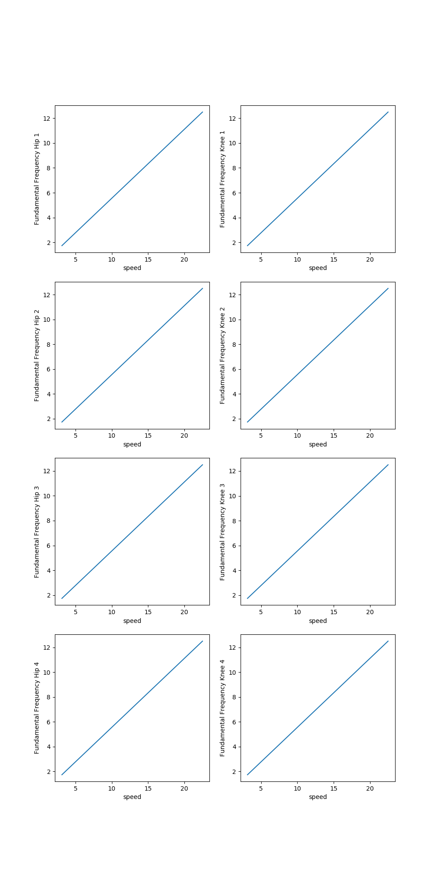
Supervised Learning of Gait Pattern
A proportional relationship between fundamental frequency of gait signal and speed of quadruped was established
Using the fundamental frequency as input, it was demonstrated that the proposed network is capable of generating gait patterns
Hip Joint Signal
Frequency spectrum of hip joint signal
Notes:
Analysis of the assumed ideal gait pattern shows that there is a linear relationship between the fundamental frequency of the gait patterns and the speed of motion. Thus integer multiples of the gait pattern are provided as input to the Oscillator which then generates appropriate rhythms.

Slide 6
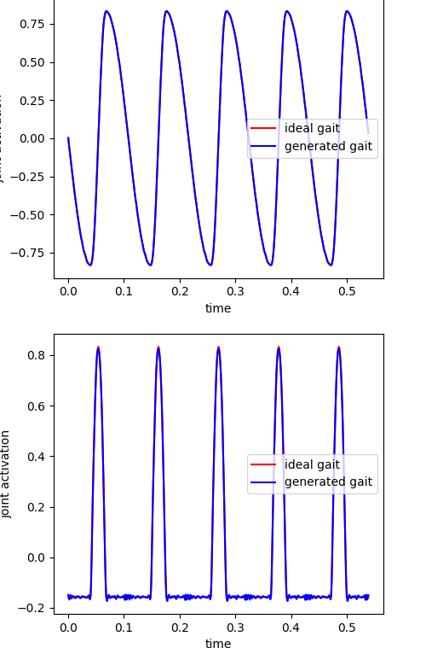
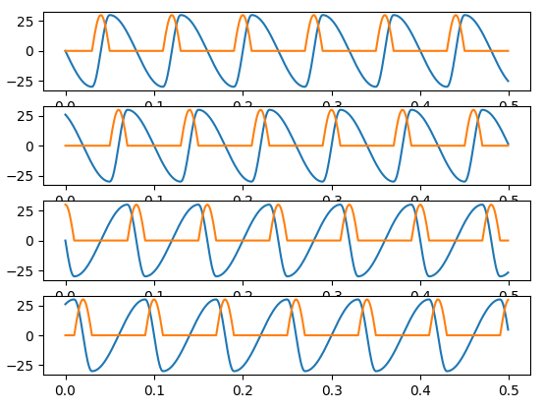
Supervised Learning of Gait Pattern
Gait Pattern for Creep Gait
Model was able to reconstruct gait signal with 100% accuracy for unto 10 different patterns at a time
Notes:
The image of the left shows the ideal patterns and the patterns on the right are normalised joint activations

Slide 7
Fitness Function
Evaluation Criteria to measure stability, speed and energy consumption
Both the aforementioned training frameworks require a Fitness Function [1]
Fitness Function must measure the following
Stability Criteria, $S$
Energy Efficiency Criteria, $E$
$F=k_{s}S_{i}+k_{e}E_{i}$ where
F is the Fitness Value
$k_{s}$ and $k_{e}$ are parameters to account for relative importance of each criteria
Notes:
A fitness function was formulated for fine-tuning of the ideal gait pattern. It consists of stability criteria and energy efficiency criteria

Slide 8
Stability Criteria
Evaluation of Dynamic and Static Stability of the Quadruped
A Quantitative Measure of quadruped’s dynamic stability
The Criteria must not only take into account current stability but must also anticipate the stability at the next time instance, given the state of motion of the quadruped, like an animal does
Yan Jia, Xiao Luo and others [2] in their paper propose a modified ZMP based stability evaluation criteria
The main idea is that at a certain state, the motion of the robot is considered to be stable if the torque caused by the ground-reaction force can prevent the robot from tumbling around any support boundary
Notes:
Read the text

Slide 9
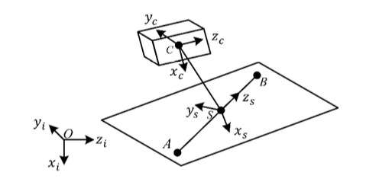
Stability Criteria
Coordinate Systems used
There are two coordinate systems of interest-
The Inertial Coordinate system
The Support Coordinate system
The Support Coordinate has z-axis along the support line AB and x axis perpendicular to the current support plane
Notes:
A new coordinate system is proposed to simplify computations

Slide 10
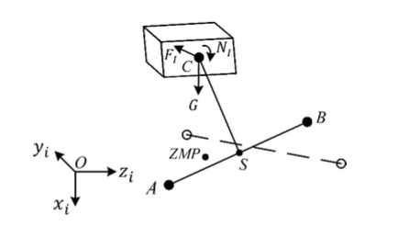
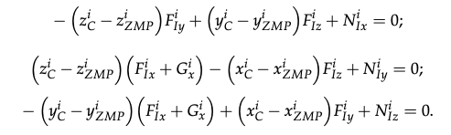
Stability Criteria
Equations for Zero Moment Point
The characteristic equations of ZMP. The inertial force and inertial moment here need to be computed by a dynamic analysis of the quadruped performed later in the report
The force schematic used to calculate the position of ZMP.
Here G is gravity, F is the inertial force on COM C, N is the inertial moment
Notes:
The stability criteria is based on a modified definition of the Zero moment point, that is the point about which moment of the robot is zero.

Slide 11
Stability Criteria
Virtual Support Plane and Modified Zero Moment Point
The paper assumes that a robot is stable if the current or next set of support feet can provide the moment necessary to prevent the robot from tipping in any direction
A Virtual Support Plane is proposed and it is proposed that if the modified ZMP proposed in the paper lies within this Virtual Support Plane, then the robot motion will be stable
The Proposed Modified ZMP in the paper also includes a velocity term to account for the motion of the quadruped
Notes:
Read the text. At last say, this modified formulation allows for DDPG to learn anticipation of future possibilities given current velocity

Slide 12
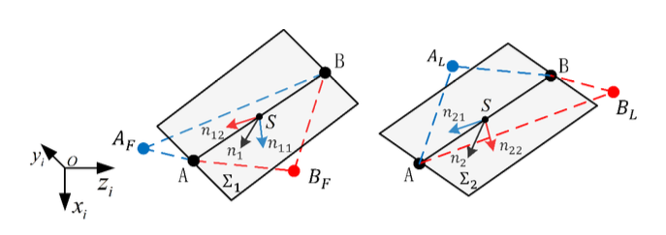
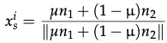
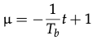
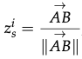
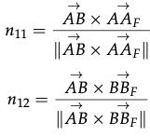
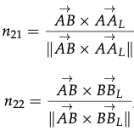
Stability Criteria
Calculating the Virtual Support Plane
S is the origin of the support coordinate system on which the ZMP will lie
$n_{1}$ is the normal vector to the plane $AA_{F}BB_{F}$
$n_{2}$ is the normal vector to the place $AA_{L}BB_{L}$
$x_{s}^{i}$, $y_{s}^{i}$ and $z_{s}^{i}$ are the normal vectors to the virtual support plane in the inertial frame of reference
$T_{b}$ is the duration between two adjacent steps and t is the time gap between the current running time and the time point when the previous support line disappeared
Notes:
Equations of the support plane, details in the report.

Slide 13
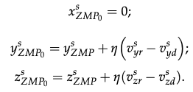
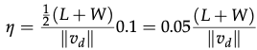
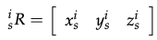
Stability Criteria
Calculation of Modified Zero Moment Point
Zero Moment Point is the point at which the resultant moment on a body is zero
Modified Zero Moment Point should-
Assess the current stability more efficiently and accurately
Provide a reference to eliminate undesired velocity during motion planning
$ZMP_{o}$ can be used to compute 3 measures of dynamic stability
Equations to calculate modified ZMP in support coordinate system. $v^{s}$ and $v^{d}$ are the actual and expected velocities in support coordinate system
L and W are the effective length and width respectively of the quadruped
Rotation Matrix for transformation from support to inertial coordinate system
Notes:
Modified ZMP definition. Read point here and its sub points.

Slide 14
Stability Criteria
Calculation of the metric $S$
The following three choices for $S$ can be calculated using $ZMP_{o}$-
Distances between $ZMP_{o}$ and the boundaries of the virtual-support quadrilateral in the support plane
Angle between the vector pointing from CoM to $ZMP_{o}$ and the normal vector of the virtual support place
Distance between $ZMP_{o}$ and the support line
The assumption in the paper that the legs have negligible weight compared to the rest of the body does not hold for the quadruped used
There is a need for evaluation of the repercussions on the concepts introduced
Notes:
The stability criteria is a weighted sum of three quantities, then read the text

Slide 15
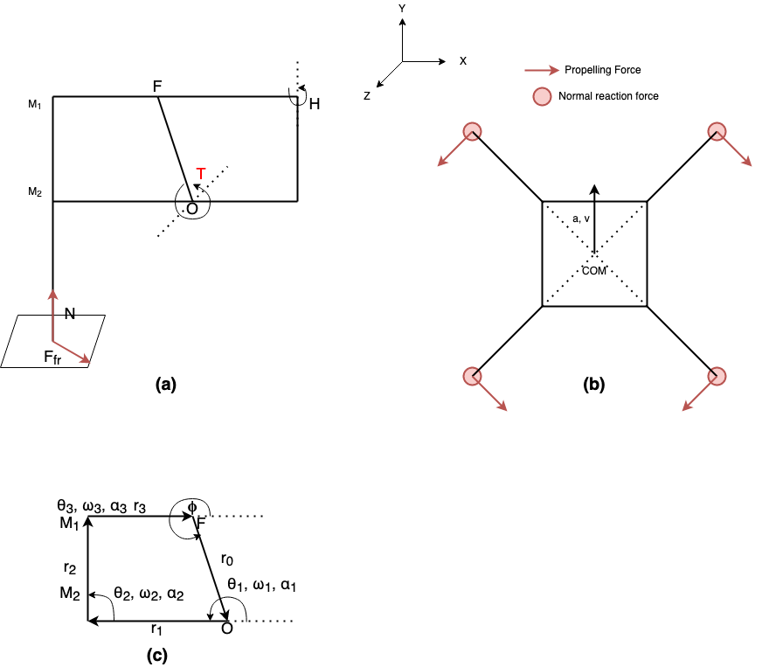
Calculating Stability Criteria
Computing ZMP for the available quadruped
The following figure depicts the simplified model of the quadruped.
$F_{fr}$ is the force due to friction acting at the point of contact. This is also the propelling force on the quadruped
$N$ is the normal reaction force from the ground
$θ$, $ω$ and $α$ are the state of the joints in the four bar linkage in (c)
Simplified model of the leg of the quadruped
Simplified model of the quadruped as seen form the top
Simplified four bar linkage to model the knee of the quadruped
Notes:
A simple kinematic and dynamic analysis of the quadruped was also needed, details of which can be found in the report.

Slide 16
Calculating Stability Criteria
Relationship between knee joint activation and four bar linkage model angular positions
Of the four angular positions that in the four bar linkage model of the knee joint, the angular position at $O$, $θ_{1}$ and $F$, $ϕ$ are known (being the controlled angle). Thus, the other angular positions must also be formulated in terms of $θ_{1}$ and $ϕ$. $l$, $β_{1}$, $β_{2}$ and $δ$ are intermediate variables.
$$l=\sqrt{{\overset{⃗}{|r_{0}|}}^{2}+{\overset{⃗}{|r_{1}|}}^{2}-2|r_{0}||r_{1}|cos(θ_{1}-ϕ+π)}$$
$$δ=arcsin(\frac{l}{|\overset{⃗}{r_{3}}|}sinβ_{2})$$
$$β_{1}=arcsin(\frac{|\overset{⃗}{r_{1}}|}{l}sin(θ_{1}-ϕ+π))$$
$$θ_{2}=β_{2}-β_{1}+ϕ-π$$
$$β_{2}=arccos\frac{|\overset{⃗}{r_{2}}|^{2}+l^{2}-|\overset{⃗}{r_{3}}|^{2}}{2|\overset{⃗}{r_{3}}|l}$$
$$θ_{3}=-β_{1}-δ+ϕ-π$$
Notes:
Skip

Slide 17
Calculating Stability Criteria
Linkage vector in knee joint four bar linkage model
$\overset{⃗}{r_{1}}=\left[\begin{aligned}L_{1}cosθ_{1} \\ L_{1}sinθ_{1} \\ 0\end{aligned}\right]$
$\overset{⃗}{r_{2}}=\left[\begin{aligned}L_{2}cosθ_{2} \\ L_{2}sinθ_{2} \\ 0\end{aligned}\right]$
$\overset{⃗}{r_{3}}=\left[\begin{aligned}L_{3}cosθ_{3} \\ L_{3}sinθ_{3} \\ 0\end{aligned}\right]$
Here $\overset{⃗}{r_{0}}$ is fixed and $ϕ$, the angle between $\overset{⃗}{r_{0}}$ and x-axis is also fixed
$\overset{⃗}{r_{0}}=\left[\begin{aligned}L_{0}cosϕ \\ L_{0}sinϕ \\ 0\end{aligned}\right]$
$L_{0}$, $L_{1}$, $L_{2}$ and $L_{3}$ are the length of the three linkages given by $\overset{⃗}{r_{0}}$, $\overset{⃗}{r_{1}}$, $\overset{⃗}{r_{2}}$ and $\overset{⃗}{r_{3}}$ respectively.
$L_{0}$, $L_{1}$, $L_{2}$ and $L_{3}$ are the length of the three linkages given by $\overset{⃗}{r_{0}}$, $\overset{⃗}{r_{1}}$, $\overset{⃗}{r_{2}}$ and $\overset{⃗}{r_{3}}$ respectively.
Notes:
Skip

Slide 18
Calculating Stability Criteria
Kinematics model of the Knee Joint
The following equations characterise the kinematic model of the knee joint.
$$\overset{⃗}{r_{1}}+\overset{⃗}{r_{2}}+\overset{⃗}{r_{3}}+\overset{⃗}{r_{0}}=\overset{⃗}{0}$$
$$r_{1x}=L_{1}cosθ_{1}$$
$$r_{2x}=L_{2}cosθ_{2}$$
$$r_{2x}=L_{2}cosθ_{2}$$
$$\overset{⃗}{v_{0}}+\overset{⃗}{v_{1}}+\overset{⃗}{v_{2}}+\overset{⃗}{v_{3}}=\overset{⃗}{0}$$
$$r_{1y}=L_{1}sinθ_{1}$$
$$r_{2y}=L_{2}sinθ_{2}$$
$$r_{2y}=L_{2}sinθ_{2}$$
$$r_{1z}=0$$
$$r_{2z}=0$$
$$r_{2z}=0$$
$$\overset{⃗}{a_{0}}+\overset{⃗}{a_{1}}+\overset{⃗}{a_{2}}+\overset{⃗}{a_{3}}=\overset{⃗}{0}$$
These relationships are shorthand for the components of the vectors $\overset{⃗}{r_{0}}$, $\overset{⃗}{r_{1}}$, $\overset{⃗}{r_{2}}$ and $\overset{⃗}{r_{3}}$
These aforementioned relationships arise as the four bar linkage is stationary with respect to $F$ and $O$.
$$r_{0x}=L_{0}cosϕ$$
$$r_{0y}=L_{0}sinϕ$$
$$r_{0z}=0$$
Notes:
Skip

Slide 19
Calculating Stability Criteria
Calculating $ω$ and $α$
$$\overset{⃗}{ω_{0}}=\left[\begin{aligned}0 \\ 0 \\ 0\end{aligned}\right]$$
$$\overset{⃗}{ω_{1}}=\left[\begin{aligned}0 \\ 0 \\ ω_{1z}\end{aligned}\right]$$
$$\overset{⃗}{ω_{2}}=\left[\begin{aligned}0 \\ 0 \\ ω_{2z}\end{aligned}\right]$$
$$\overset{⃗}{ω_{3}}=\left[\begin{aligned}0 \\ 0 \\ ω_{3z}\end{aligned}\right]$$
$$\overset{⃗}{v_{O}}=0$$
The linkage $\overset{⃗}{r_{0}}$ is fixed
$$\overset{⃗}{v_{1}}=\overset{⃗}{ω_{1}}×\overset{⃗}{r_{1}}$$
Only rotation with $ω_{1}$ about origin of linkage
$$\overset{⃗}{v_{2}}=\overset{⃗}{ω_{2}}×\overset{⃗}{r_{2}}$$
Only rotation with $ω_{2}$ about origin of linkage
$$\overset{⃗}{v_{3}}=\overset{⃗}{ω_{3}}×\overset{⃗}{r_{3}}$$
Only rotation with $ω_{3}$ about origin of linkage
Notes:
Skip

Slide 20
Calculating Stability Criteria
Calculating $ω$ and $α$
$$\overset{⃗}{v_{0}}=\left[\begin{aligned}0 \\ 0 \\ 0\end{aligned}\right]$$
$$\overset{⃗}{v_{1}}=\left[\begin{aligned}-ω_{1z}r_{1y} \\ ω_{1z}r_{1x} \\ 0\end{aligned}\right]$$
$$\overset{⃗}{v_{2}}=\left[\begin{aligned}-ω_{1z}r_{1y} \\ ω_{1z}r_{1x} \\ 0\end{aligned}\right]$$
$$\overset{⃗}{v_{3}}=\left[\begin{aligned}-ω_{1z}r_{1y} \\ ω_{1z}r_{1x} \\ 0\end{aligned}\right]$$
Since $\overset{⃗}{v_{0}}+\overset{⃗}{v_{1}}+\overset{⃗}{v_{2}}+\overset{⃗}{v_{3}}=\overset{⃗}{0}$, we get the following equations.
$$0-ω_{1z}r_{1y}-ω_{2z}r_{2y}-ω_{3z}r_{3y}=0$$
$$ω_{2z}=-ω_{1z}\frac{r_{1y}r_{3x}-r_{3y}r_{1x}}{r_{2y}r_{3x}-r_{3y}r_{2x}}$$
$$0+ω_{1z}r_{1x}+ω_{2z}r_{2x}+ω_{3z}r_{3x}=0$$
$$ω_{3z}=-ω_{1z}\frac{r_{2y}r_{1x}-r_{1y}r_{2x}}{r_{2y}r_{3x}-r_{3y}r_{2x}}$$
Solving the above two we get $ω_{2z}$ and $ω_{3z}$
Notes:
Skip

Slide 21
Calculating Stability Criteria
Calculating $ω$ and $α$
$$\overset{⃗}{α_{0}}=\left[\begin{aligned}0 \\ 0 \\ 0\end{aligned}\right]$$
$$\overset{⃗}{α_{1}}=\left[\begin{aligned}0 \\ 0 \\ α_{1z}\end{aligned}\right]$$
$$\overset{⃗}{α_{2}}=\left[\begin{aligned}0 \\ 0 \\ α_{2z}\end{aligned}\right]$$
$$\overset{⃗}{α_{3}}=\left[\begin{aligned}0 \\ 0 \\ α_{3z}\end{aligned}\right]$$
$${\overset{⃗}{a}}_{0}=0$$
The linkage $\overset{⃗}{r_{0}}$ is fixed
$${\overset{⃗}{a}}_{1}={\overset{⃗}{α}}_{1}×{\overset{⃗}{r}}_{1}+{\overset{⃗}{ω}}_{1}×{\overset{⃗}{ω}}_{1}×{\overset{⃗}{r}}_{1}$$
Only rotation with $α_{1}$ about origin of linkage
$$\overset{⃗}{a_{2}}=\overset{⃗}{α_{2}}×\overset{⃗}{r_{2}}+\overset{⃗}{ω_{2}}×\overset{⃗}{ω_{2}}×\overset{⃗}{r_{2}}$$
Only rotation with $α_{2}$ about origin of linkage
$$\overset{⃗}{a_{3}}=\overset{⃗}{α_{3}}×\overset{⃗}{r_{3}}+\overset{⃗}{ω_{3}}×\overset{⃗}{ω_{3}}×\overset{⃗}{r_{3}}$$
Only rotation with $α_{3}$ about origin of linkage
Notes:
Skip

Slide 22
Calculating Stability Criteria
Calculating $ω$ and $α$
Since $\overset{⃗}{a_{0}}+\overset{⃗}{a_{1}}+\overset{⃗}{a_{2}}+\overset{⃗}{a_{3}}=\overset{⃗}{0}$, we get the following equations.
$$0-α_{1z}r_{1y}-ω_{1z}^{2}r_{1x}-α_{2z}r_{2y}-ω_{2z}^{2}r_{2x}-α_{3z}r_{3y}-ω_{3z}^{2}r_{3x}=0$$
$$0+α_{1z}r_{1x}-ω_{1z}^{2}r_{1y}+α_{2z}r_{2x}-ω_{2z}^{2}r_{2y}+α_{3z}r_{3x}-ω_{3z}^{2}r_{3y}=0$$
Solving the above two we get $α_{2z}$ and $α_{3z}$
$$α_{2z}=\frac{r_{3x}(-α_{1z}r_{1y}-ω_{1z}^{2}r_{1x}-ω_{2z}^{2}r_{2x}-ω_{3z}^{2}r_{3x})-r_{3y}(-α_{1z}r_{1x}-ω_{1z}^{2}r_{1y}-ω_{2z}^{2}r_{2y}-ω_{3z}^{2}r_{3y})}{r_{2y}r_{3x}-r_{3y}r_{2x}}$$
$$α_{3z}=\frac{-r_{2x}(-α_{1z}r_{1y}-ω_{1z}^{2}r_{1x}-ω_{2z}^{2}r_{2x}-ω_{3z}^{2}r_{3x})+r_{2y}(-α_{1z}r_{1x}-ω_{1z}^{2}r_{1y}-ω_{2z}^{2}r_{2y}-ω_{3z}^{2}r_{3y})}{r_{2y}r_{3x}-r_{3y}r_{2x}}$$
Notes:
Skip

Slide 23
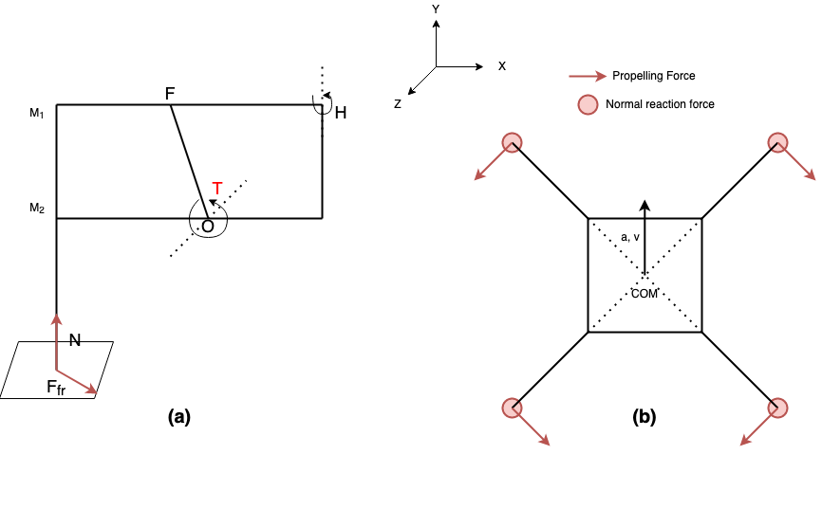
Calculating Stability Criteria
Dynamic Model of the Available Quadruped
$$∑\overset{⃗}{F_{fr}}+∑\overset{⃗}{N}-m\overset{⃗}{g}=m\overset{⃗}{a}$$
$$\underset{i}{∑}\overset{⃗}{F_{fr}}×R_{i}+\underset{i}{∑}\overset{⃗}{N}×R_{i}=I_{R}\overset{⃗}{α_{R}}$$
The above two equations depict the dynamics of the quadruped in vector form. Rotation is possible about the $y$ and $z$ axes, while translation is only possible along the $y$ and $z$ axes.
Notes:
Skip

Slide 24
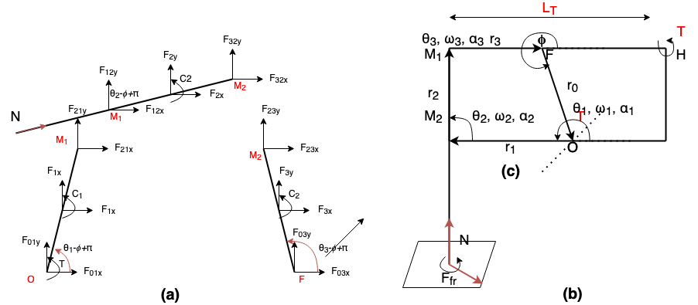
Calculating Stability Criteria
Stance Dynamics
Illustration of all forces acting on the four bar linkage in the knee during stance phase. The segment M1H will be rigid during stance
A simplified model of a leg. $N$ and $F_{fr}$ are normal reaction and friction forces respectively
Notes:
Skip

Slide 25
Calculating Stability Criteria
Stance Dynamics
$$F_{01x}+F_{1x}+F_{21x}=0$$
$$F_{01y}+F_{1y}+F_{21y}=0$$
$$\overset{⃗}{F_{23}}=-\overset{⃗}{F_{32}}$$
$$F_{01y}+F_{1y}+F_{21y}=0$$
$$C_{1}=0$$
$$\overset{⃗}{F_{21}}=-\overset{⃗}{F_{12}}$$
$$F_{12x}+F_{2x}+F_{32x}+Ncosθ_{2}-ϕ+π=0$$
$$C_{2}=0$$
$$F_{12y}+F_{2y}+F_{32y}+Nsinθ_{2}-ϕ+π=0$$
$$C_{3}=0$$
$$F_{01x}+F_{1x}+F_{21x}=0$$
$$T+C_{1}-F_{1x}\frac{|\overset{⃗}{r_{1}}|}{2}cosθ_{1}-ϕ+π+F_{1y}\frac{|\overset{⃗}{r_{1}}|}{2}cosθ_{1}-ϕ+π+F_{21y}|\overset{⃗}{r_{1}}|cosθ_{1}-ϕ+π-F_{21x}|\overset{⃗}{r_{1}}|sinθ_{1}-ϕ+π=0$$
$$C_{2}-F_{2x}\frac{|\overset{⃗}{r_{2}}|}{2}cosθ_{2}-ϕ+π+F_{2y}\frac{|\overset{⃗}{r_{2}}|}{2}cosθ_{2}-ϕ+π+F_{32y}|\overset{⃗}{r_{2}}|cosθ_{2}-ϕ+π-F_{32x}|\overset{⃗}{r_{2}}|sinθ_{2}-ϕ+π=0$$
$$C_{3}-F_{3x}\frac{|\overset{⃗}{r_{3}}|}{2}cosθ_{3}-ϕ+π+F_{3y}\frac{|\overset{⃗}{r_{3}}|}{2}cosθ_{3}-ϕ+π-F_{23y}|\overset{⃗}{r_{1}}|cosθ_{1}-ϕ+π+F_{23x}|\overset{⃗}{r_{1}}|sinθ_{1}-ϕ+π=0$$
Notes:
Skip

Slide 26
Calculating Stability Criteria
$$\overset{k}{\underset{i}{∑}}N_{i}-mg=0$$
Calculating $\overset{⃗}{F_{fr}}$ and $\overset{⃗}{N}$
$\overset{⃗}{F_{fr}}$ and $\overset{⃗}{N}$ are the friction and normal reaction acting at the points of contact with the ground
To compute these forces the dynamics at the point of contact need to be considered
For a successful walking motion, there must be no slipping at the point of contact
Thus, we need to solve for equilibrium conditions there
where k is the number of legs in contact with the group
$$T-F_{fr}L_{T}=0$$
This is the condition of no slipping at the point of contact with the ground
$$∑\overset{⃗}{F_{fr}}=m\overset{⃗}{a}$$
The sum of all frictional forces are responsible for the horizontal acceleration $a$ of the quadruped
Notes:
Skip

Slide 27
Calculating Stability Criteria
Calculating Inertial Force and Moment at COM
The Inertial Force at the COM is given by $m\overset{⃗}{a}$, where $\overset{⃗}{a}$ is the acceleration of the COM
The Moment at COM is given by $I_{R}\overset{⃗}{α_{R}}$, which is calculated by solving the dynamics of the quadruped
Once the Inertial Force and Moment at the COM are known, the modified ZMP can computed using the method proposed in [2], which can then be used to compute the stability criteria
Notes:
Skip

Slide 28
Solving Quadruped Dynamics
Solving a system of linear equations
The dynamics equations of the quadruped together form a system of 69 equations and 69 variables
$AX=B$ is a system of linear equations with $X$ being the vector of the unknowns, $A$ the matrix of coefficients and $B$ the constants
$X=A^{-1}B$ gives the solution to the aforementioned system of linear equations
Notes:
Skip

Slide 29
Solving Quadruped Dynamics
Solving a system of linear equations
Some simplifying assumptions were made to formulate the system of linear equations
A binary factor $γ_{i}$ was introduced for each leg. If $γ_{i}=0$ there is no contact with the ground at the leg, else there is contact
If $γ_{i}=γ_{j}=0$, then $N_{i}=N_{j}=0$.
If $γ_{i}=γ_{j}=1$, then $N_{i}=N_{j}≠0$
The resistive force at the hip joint is given by $ϵ_{i}$ when leg $i$ is not in contact with the ground
Movement is on a flat surface with coefficient of friction $μ$
At least two legs are in contact with the ground at all points of time
Notes:
Skip

Slide 30
Energy Efficiency Criteria
Calculation of metric $E$
$$P_{avg}=\frac{1}{T}\overset{4}{\underset{i=1}{∑}}\overset{2}{\underset{j=1}{∑}}∫_{0}^{T}|τ_{i,j}{\overset{·}{θ}}_{i,j}(t)|dt$$
Energy Criteria E measures the energy efficiency of the quadruped
The Criteria is inspired by the objective function used in [9]
There are three aspects of the Energy Efficiency Criteria
Mean Power $P_{avg}$
Mean Power Derivation $D_{avg}$
Mean Torque Consumption $P_{L}$
$$E=P_{avg}+D_{avg}+P_{L}$$
$$D_{avg}=\sqrt{\frac{1}{T}∫_{0}^{T}(\overset{4}{\underset{i=1}{∑}}\overset{2}{\underset{1}{∑}}τ_{i,j}{\overset{·}{θ}}_{i,j}(t)-P_{avg})^{2}dt}$$
$$P_{L}=\frac{1}{T}\overset{4}{\underset{i=1}{∑}}\overset{2}{\underset{j=1}{∑}}∫_{0}^{T}(τ_{i,j}(t))^{2}dt$$
Notes:
Consists of three parts. Objective is to ensure minimum usage of energy instantaneously as well as on average.

Slide 31
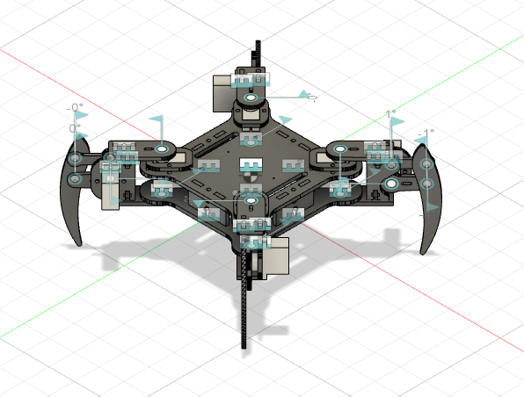
3D model
Quadruped Assembly on Fusion 360
Need for 3D model-
Precise mass of quadruped components
Precise Position of leg COM
Moment of Inertia in Knee four bar linkage
Easier method for URDF model generation
Calculating Joint motion ranges
Fusion 360 can also be used for ML
Notes:
Fusion 360 model developed for the above reasons. Read text.

Slide 32
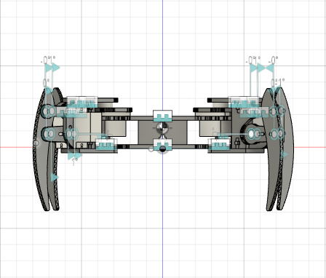
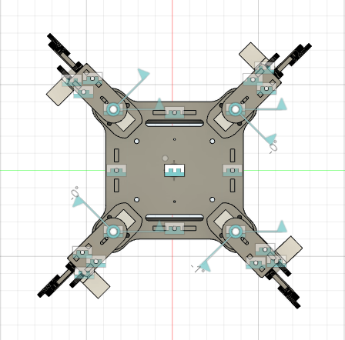
3D model
Quadruped Assembly on Fusion 360

Slide 33
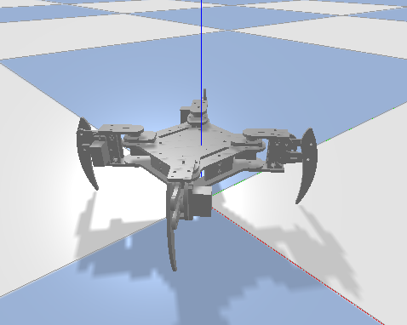
PyBullet
Collision and Inertia Model of the quadruped
Collisions in the quadruped to be modelled using simple shapes like cylinder, boxed and spheres
There is a need for a simpler model as the collision model using meshes requires compute power not currently available
Notes:
Skip

Slide 34
ROS and Gazebo
Due to the limitations of the PyBullet API, the environment for RL had to be changed from PyBullet to ROS and Gazebo
ROS implementation has a much lower simulation to hardware transfer time and Gazebo provides the flexibility of adding sensors into the simulations as needed
Pybullet lacks a forward kinematics module that is needed for computing the future contact positions for the Stability Criteria
MoveIt! Plugin with Gazebo can be very easily be used to get forward as well as inverse kinematics of the quadruped
Gazebo also simplifies Stability Criteria Calculation as it directly provides callbacks for dynamics and kinematics from the physics engine used
Notes:
However, the exact model was too computational expensive for RL. Thus a simplified model was developed using ROS. Read point 2, 4 and 5.

Slide 35
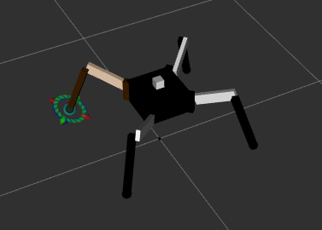
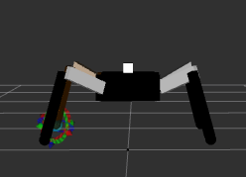
ROS and Gazebo
Simplified Quadruped Model
The initially developed quadruped URDF model required very high computational power for proper simulation, which is not available
A simplified URDF model was developed to simulate the kinematics and dynamics of the quadruped
Notes:
The is the simplified quadruped description. To ensure exact emulation MePed behaviour an extra degree of freedom was introduced, which was then slaved to the knee joint activation values.

Slide 36
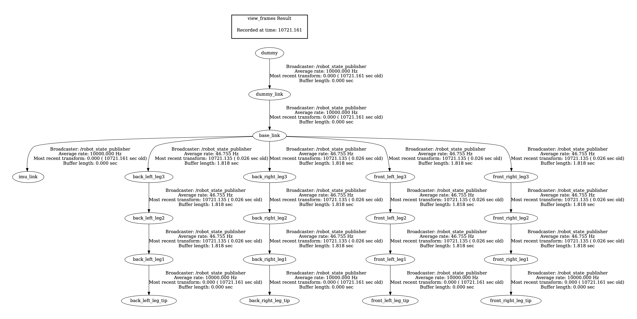
ROS
Quadruped Model
Notes:
This is the TF2.0 transformation tree used for kinematic and dynamic calculations and frame of reference transformations in ROS

Slide 37
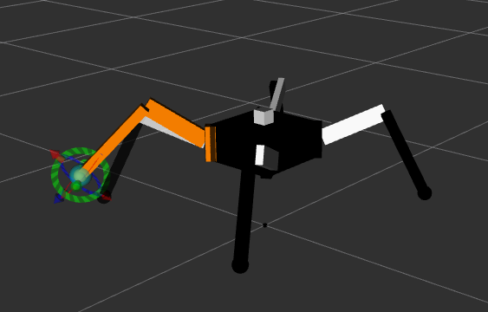
ROS
Quadruped Model - MoveIt!
A
“MoveIt!” is a ROS path planning package used to plan manipulator paths
“MoveIt!” was used to track the position of as end-effector, that is the leg tip as the leg moved from point A to point B
This package was used in the computation of the stability reward and replaced the previous derived kinematics model of the quadruped
B
Notes:
Skip

Slide 38
ROS
Sensors
The following sensors are mounted on the quadruped simulation model:
IMU sensor:
To obtain orientation, linear acceleration and angular velocity
Sensed information used to construct robot state
Mounted at the top of the base link
Contact Sensors
To obtain Point of contact, normal forces and other contact related information
Used to compute stability criteria of the reward
Notes:
Read text

Slide 39
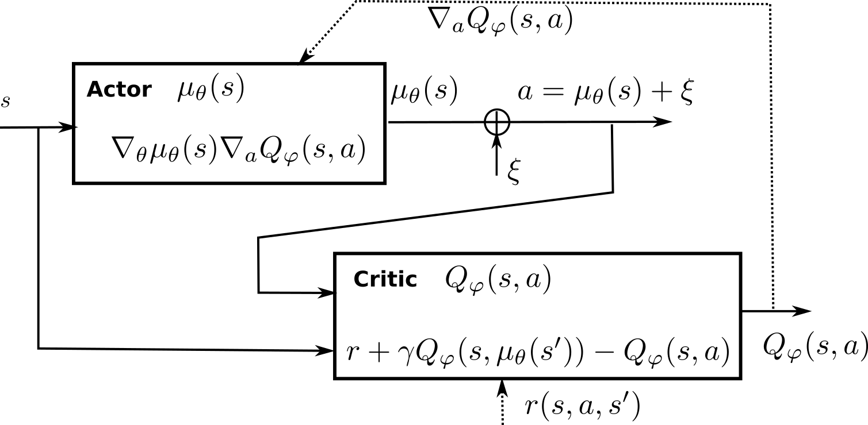
Reinforcement Learning
Deep Deterministic Policy Gradient
Notes:
RL algorithm that uses an actor, critic, target actor and target critic to train a NN. Explain how it works from the image. Action produced, reward calculated, then target critic produces next q values which are then predicted by current critic. The Q values are used to compute gradient wrt action and used to update actor parameters.

Slide 40
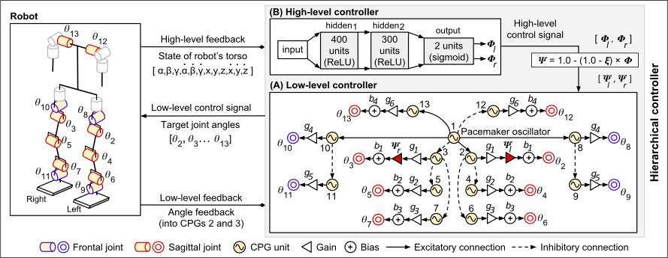
Reinforcement Learning
DDPG : Inspiration
Notes:
DDPG inspiration comes from an use case of DDPG for bipedal walking

Slide 41
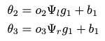
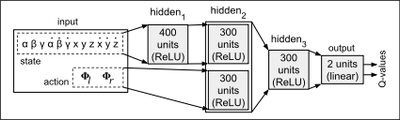
Reinforcement Learning
DDPG : Inspiration
The proposed DDPG model is inspired by the DDPG for the higher level controller for the biped, proposed in [6]
The CPG model in [6] is tuned using GA instead of inclusion in the DDPG
The Actor Network in [6] produces the $ψ_{l}$ and $ψ_{r}$ which are used to steer the biped by modifying the gait signal according to the following equations:
The proposed DDPG model combines CPG and MLP training to tune gait generation in a single step
Critic Network in [6]
Notes:
Read text.

Slide 42
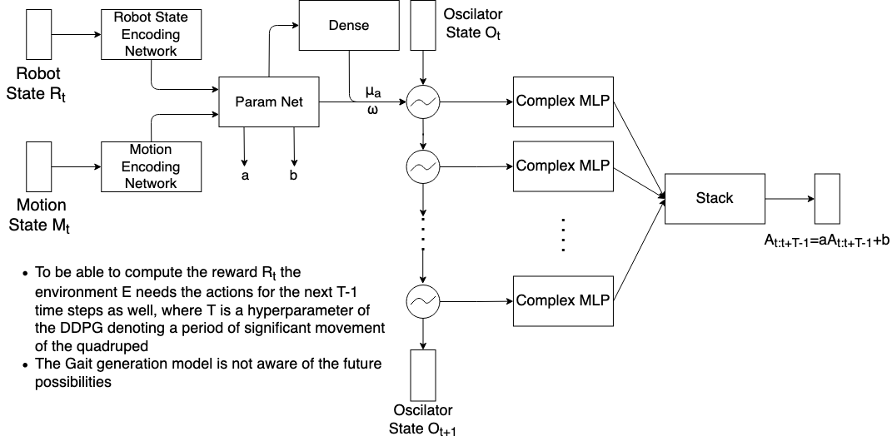
Reinforcement Learning
Actor Network
$A_{t}$ will be the joint activations produced by the network at timestep t
$A_{t+1:t+T}$ are used only for reward calculation and then discarded
$O_{t+1}$ is produced by the CPG at timestep t
State produced by the CPG after timestep t are discarded
Such implementation of the Actor Network produces a sliding time window over $2T+1$ actions taken by the quadruped around any timestep t
Unrolled Actor Network
Notes:
Read text on right

Slide 43
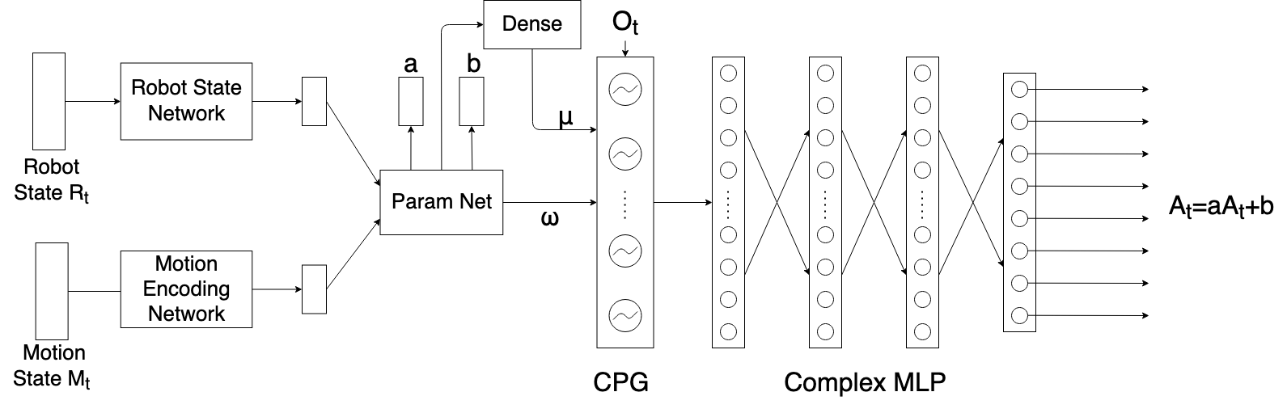
Reinforcement Learning
Snapshot of Actor Network during inference, at time step t
Notes:
Current time step values

Slide 44
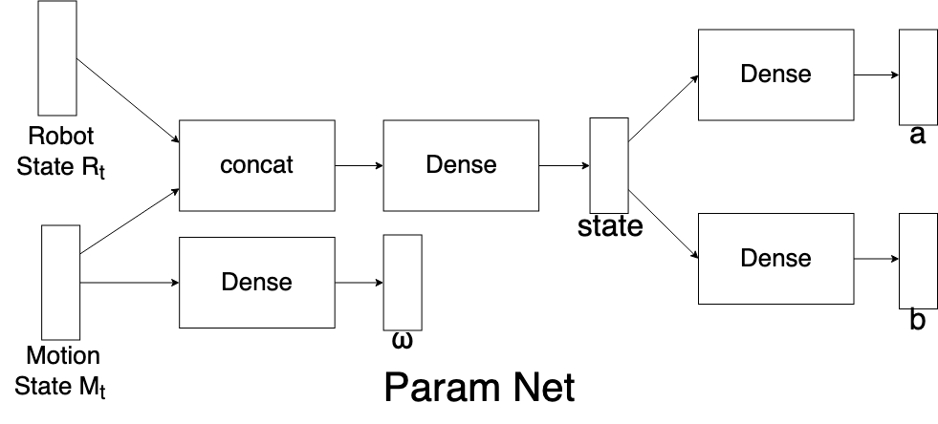
Reinforcement Learning
Param Net
Param Net outputs CPG fundamental frequency $ω$, mean of joint activation $b$, amplitude of joint activations $a$ and a state vector combining all input states
Notes:
Read Text

Slide 45
Reinforcement Learning
Snapshot of Actor Network during inference, at timestep t
The output of the Robot State Encoding Network and the CPG are of the same size, that is the number of oscillators in the CPG
The Robot State Encoding Network Output has to be converted into a complex number before it is passed to the complex dense layer
Both the complex dense layers before the Complex MLP output a vector of the same size, which is added and consequently passed to the Complex MLP as input and passed onto the next iteration as state of the intermediate RNN
Notes:
Read text

Slide 46
Reinforcement Learning
Snapshot of Actor Network during inference, at timestep t
The Actor gives two outputs $μ_{a}$ and $A_{t}$
$μ_{a}$ is the normalised gait amplitude. The gait amplitude is limited within a range of $[0,\frac{π}{3}]$. $μ_{a}=1$ implies amplitude of $\frac{π}{3}$
$A_{t}$ is the normalised gait signal
The vector $μ_{a}∘A_{t}$ is fed to the quadruped for gait generation
The Normalisation is performed to improve convergence of the Actor model during pre-training
Notes:
Skip

Slide 47
Reinforcement Learning
Actor Network: Oscillator Layer
Hopf Oscillator was used within the Oscillator layer
The oscillator was chosen because of its limit cycle behaviour at all parameter values
A Oscillator Layer serves as the recurrent layer within the actor and generates the basis signals which are then combined by the complex MLP to produce the gait signal
$$\overset{·}{z}=(μ-∣z∣^{2})z-zω$$
Complex Equation of Hopf Oscillator
$$x_{t+1}=x_{t}+(-yω+x(μ-x^{2}-y^{2}))dt$$
$$y_{t+1}=y_{t}+(xω+y(μ-x^{2}-y^{2}))dt$$
Cartesian Equations of Hopf Oscillator
Notes:
The Hopf oscillator is used to generate rhythms. The limit cycle behaviour is leveraged. The oscillation obtained serve as basis as in Fourier series and then the complex MLP modifies all the basis to create a required signal.

Slide 48
Reinforcement Learning
Robot State $R_{t}$:
Current Joint Angles
Difference between current and last joint positions
Orientation
Angular Velocity
Linear Acceleration
Joint Torques
Joint Velocities
Quadruped Velocity
Quadruped Position
Last Quadruped Position
Force on Quadruped
Moment on Quadruped
Position of CoM
Gravity
Actor Network : State Encoding Networks
$S_{t}$ comprises of the following components:
Robot State
Motion State
Motion State $M_{t}$ :
Desired Turning
Desired Velocity
The output of the CPG and the Robot State Encoding Network are of the same size
The State Encoding Networks are simple DNNs
Notes:
Read text

Slide 49
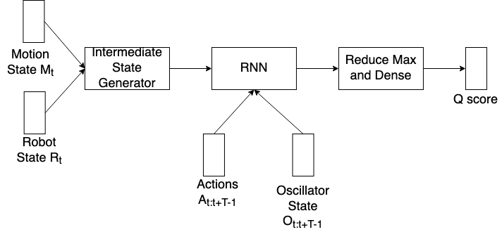
Reinforcement Learning
Critic Network
Critic is an RNN that iterates over the $O_{t-T+1:t-1}$ and $A_{t:t+T-1}$
The initial state of the RNN is generated by the intermediate state generator
The last output of the RNN is input to a dense layer to output the predicted Q scores
The Intermediate State Generator combines $R_{t}$ and $M_{t}$ into a single state vector
LSTM is used as the recurrent neuron
Notes:
Read text

Slide 50
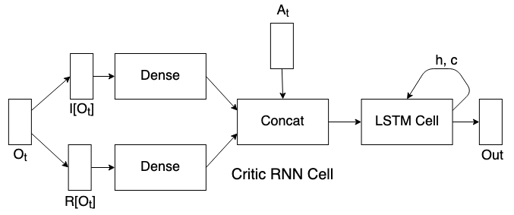
Reinforcement Learning
Critic Network : RNN
Outputs of the RNN cell are max pooled and then passed to a fully connected layer to obtain the Q Score for $A_{t}$ given $R_{t}$, $S_{t}$ and $M_{t}$. The initial state of the LSTM cell is output by the Intermediate State Generator
Notes:
This is the unrolled critic RNN

Slide 51
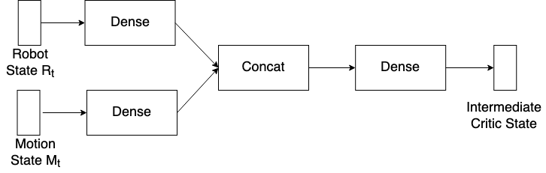
Reinforcement Learning
Critic Network : Intermediate State Generator
Notes:
The image shows details of the intermediate layers of the critic.

Slide 52
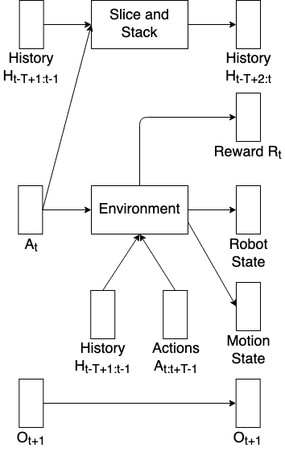
Reinforcement Learning
Environment
History consists of the action from the previous $T-1$ timesteps
History is initialised with $T-1$ repetitions of the initial joint positions
The Environment produces the Robot State and Motion State given $A_{t}$
Reward $R_{t}$ is produced by the environment given History $H_{t-T+1:t-1}$ and Actions $A_{t:t+T-1}$
The Oscillator State produced is passed on unchanged
$H_{t-T+1:t-1}$ is sliced and stacked with $A_{t}$ to get $H_{t-T+2:t}$ which is the history for the timestep $t+1$
Notes:
The environment computes the reward and the next state. History is also recorded for computation of stability reward

Slide 53
Training Procedure
Multi Stepped Training Procedure
Training of the gait generation network in two steps:
Pre-training of the Actor Network
Reinforcement Learning of DDPG
Two stepped process to ensure quicker and smoother convergence to an optima during Reinforcement Learning
The Pre-training steps provides information to the model about the process of gait, whereas Reinforcement Learning allows for fine-tuning of the knowledge from pre-training based on real world experience
Notes:
Read text

Slide 54
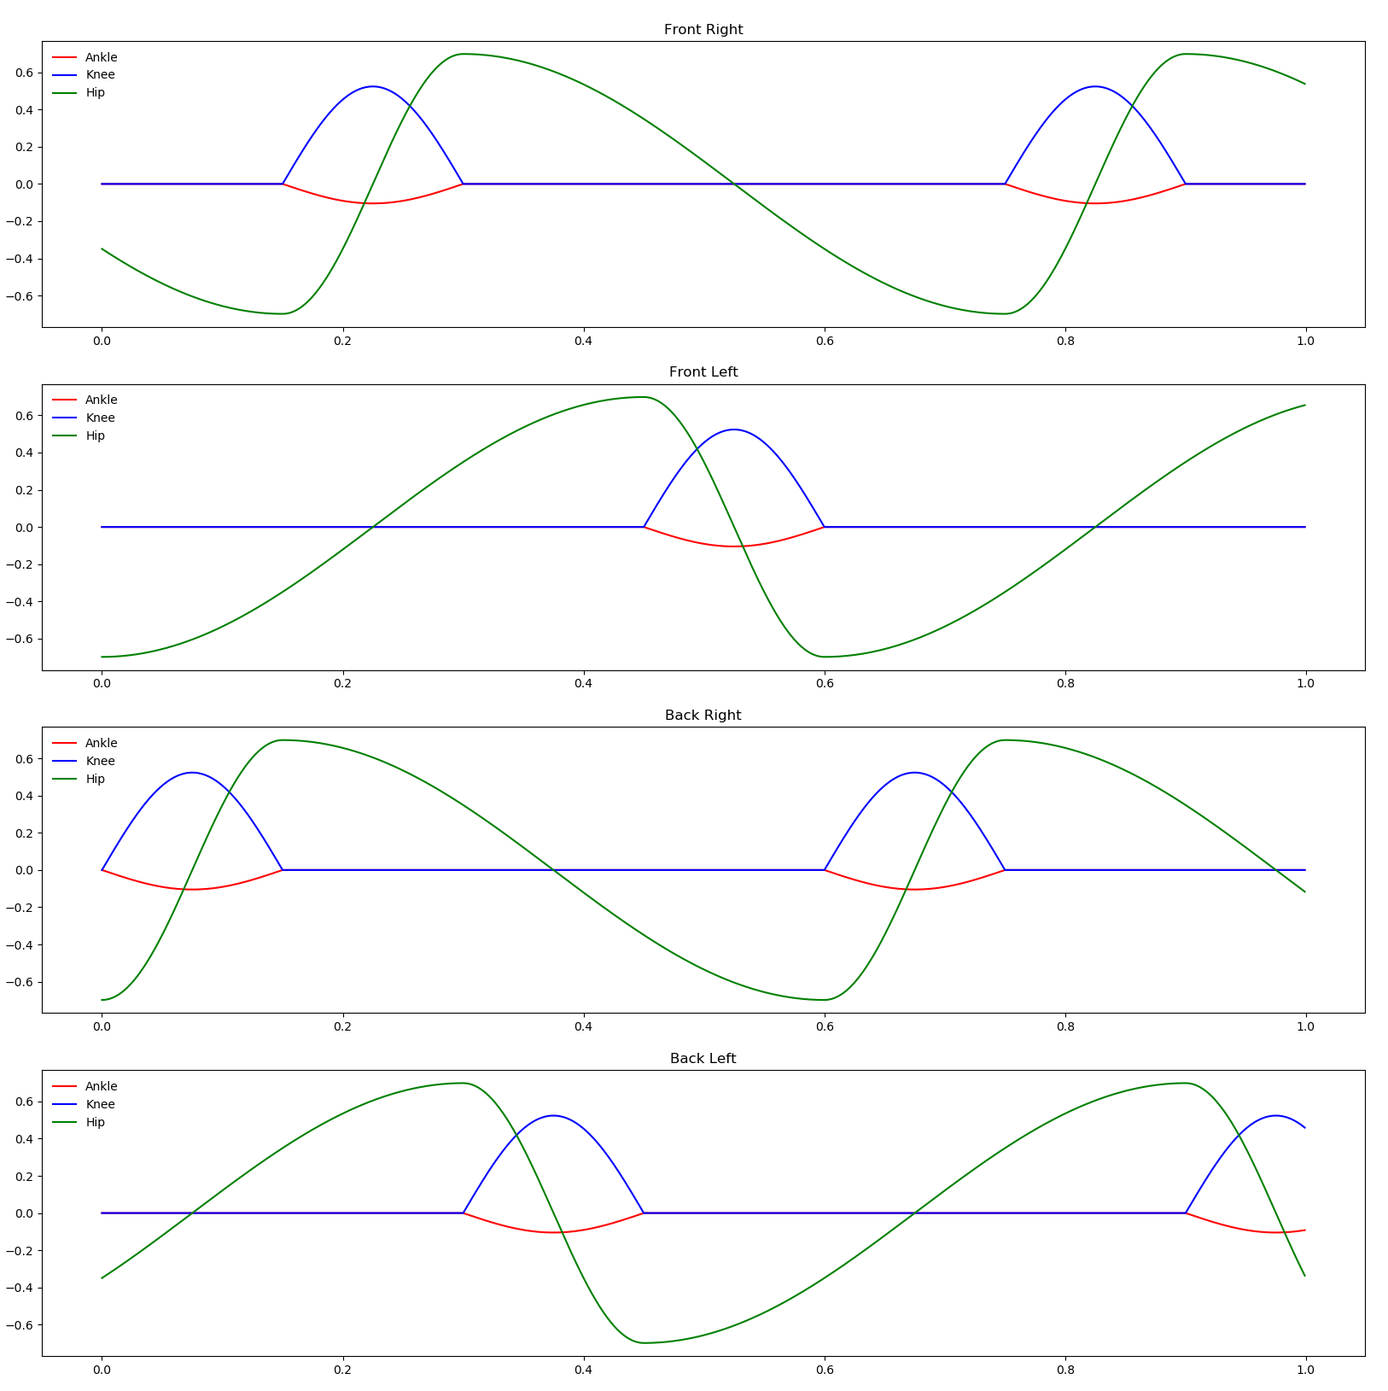
Training Procedure
Multi Stepped Training
The gait pattern used for pre-training is normalised
Pre-training only using creep gait pattern
Gait Transition and other gaits are expected to be learnt through Reinforcement Learning
Notes:
Read text

Slide 55
Training Procedure
Loss Function
Pre-training involves 4 different loss values, one for each known output
The following are the losses:
Signal MSE : Mean Squared Error for $A_{t}$
Mean MSE : Mean Squared Error for $b$
Amplitude MSE : Mean Squared Error for $a$
$ω$ MSE : Mean Squared Error for $ω$

Slide 56
Pre-training
Back-propagation Schemes
The Supervised Learning with the neural network is a multi objective optimisation problem
This leads to conflicts in updates causing the optimisation to not converge
To alleviate this conflicting effect the following schemes of optimisations were experimented with:
Entire Actor through Signal MSE, Mean MSE and Amplitude MSE only
Complex MLP through Signal MSE and Encoders and Param Net through the sum of $ω$ MSE, Mean MSE and Amplitude MSE both in the same step
Encoders and Param Net through the sum of $ω$ MSE, Mean MSE and Amplitude MSE in step 1 followed by entire Actor through the sum of signal MSE, Mean MSE and Amplitude MSE in step 2
Encoders and Param Net through the sum of $ω$ MSE, Mean MSE and Amplitude MSE in step 1 followed by entire Actor through the sum of signal MSE, $ω$ MSE, Mean MSE and Amplitude MSE in step 2
Notes:
Training procedure. Read text.

Slide 57
DDPG Training
A total of 23 experiments were run for training the DDPG agent
The following hyper parameters were tweaked across experiments:
Actor Learning Rate
Critic Learning Rate
Actor Architecture
Exploration Noise Standard Deviation
Actor RNN time steps
Maximum number of steps per episode
Number of State Dimensions
DDPG parameter $ϵ$ (determines noise to be added for exploration)
DDPG parameter $γ$ (determines target Q value)
DDPG parameter $τ$ (determines target network weights during soft update)
Experience Replay used (traditional, PER, HER)
The DDPG fails to converge, however trends in reward and critic values were observed across different experiments

Slide 58
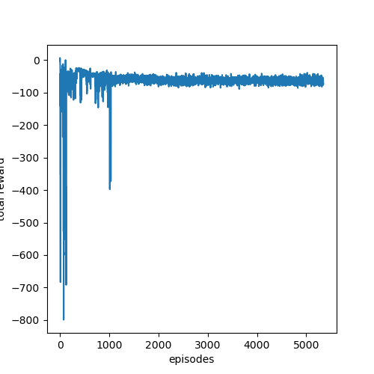
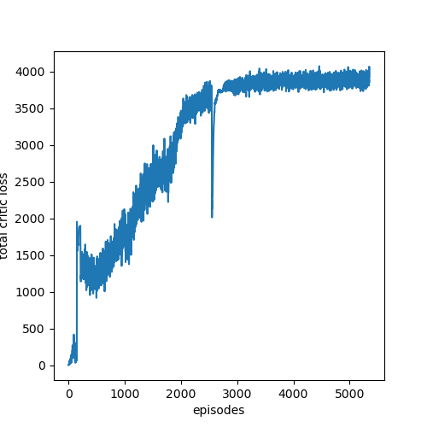
DDPG Training
Trends in Reward and Critic Loss

Slide 59
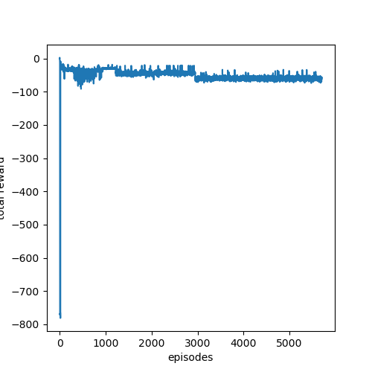
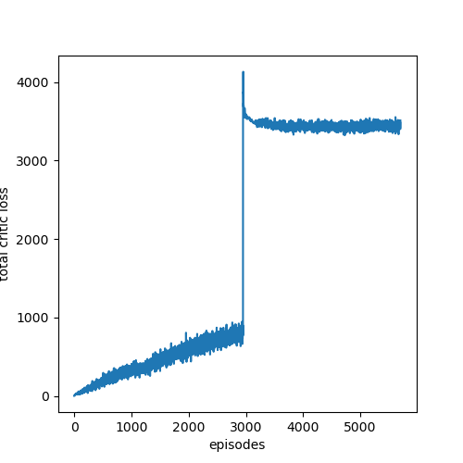
DDPG Training
Trends in Reward and Critic Loss

Slide 60
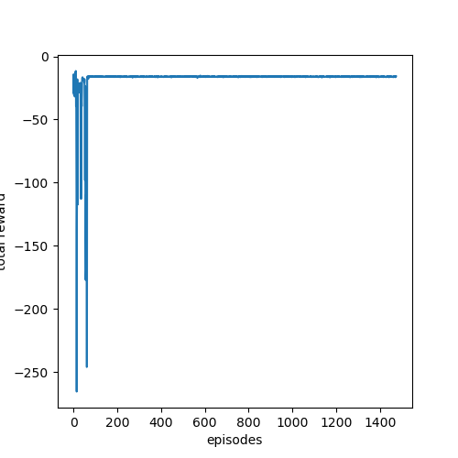
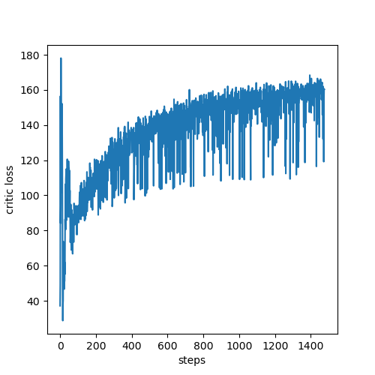
DDPG Training
Representative Trends in Reward and Critic Loss

Slide 61
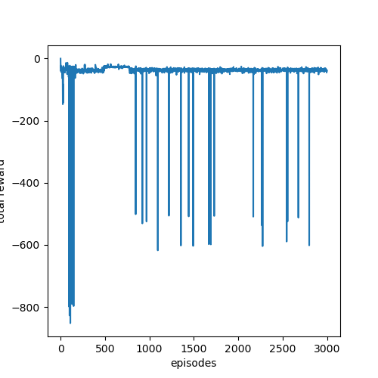
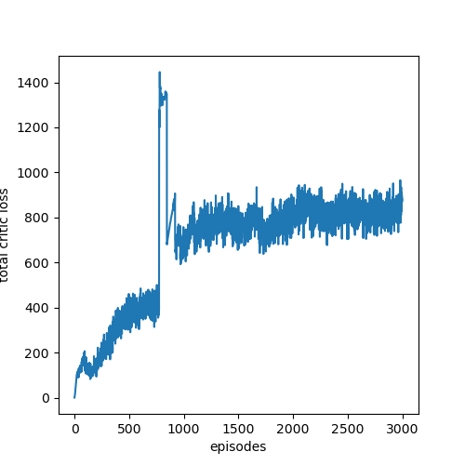
DDPG Training
Representative Trends in Reward and Critic Loss

Slide 62


DDPG Training
Representative Trends in Reward and Critic Loss

Slide 63


DDPG Training
Representative Trends in Reward and Critic Loss

Slide 64



DDPG Training
Representative Trends in Reward and Critic Loss

Slide 65


DDPG Training
Representative Trends in Reward and Critic Loss

Slide 66



DDPG Training
Representative Trends in Reward and Critic Loss

Slide 67

Random Search Baseline
Augmented Random Search Algorithm
An experiment was conducted with with ARS algorithm to determine how badly is the DDPG performing compared to an algorithm that performs random search
ARS disturbs the weights of the actor network to explore the search space for a better set of parameters
The DDPG performs was in general worse or as good as random search

Slide 68
Possibilities
Implementation of RDPG
Recurrent Deterministic Policy Gradient [12] is a variant of the DPG algorithm designed for Partially observable Markov Decision Processes
The trends in reward and critic loss show that that the DDPG agent is not able to learn from the quadruped environment
DDPG assume a Fully Observable Markov Decision Process
The failure in learning may be alleviated by increasing the state size
However, increasing the state size will also increase the difficulty in convergence by increasing the search space for optimal neural network parameters
The failure in learning may be attributed to the process being a Partially Observable Markov Decision Process

Slide 69
Timeline
July, 2020
September, 2020
November, 2020
January, 2021
March, 2021
Apri, 2021
Literature Survey
Planning and Up-skilling
Quadruped Development
Prototype Neural Network
Simulation Environment
DDPG Implementation
Neural Network Architecture
Learning
5 weeks
6 weeks
4 weeks
6 weeks
7 weeks
3 weeks
6 weeks
4 weeks
Notes:
Explain timeline. Took a break in the middle during last semester

Slide 70
References
Masuri, Ariel; Medina, Oded; Hacohen, Shlomi; Shvalb, Nir (2020) ‘Gait and Trajectory Optimization by Self-Learning for Quadrupedal Robots with an Active Back Joint’
Jia, Yan; Lua, Xiao; Han, Baoling; Liang, Guanhao; Zhao, Jiaheng; Zhao, Yuting (2018) ‘Stability Criterion for Dynamic Gaits of Quadruped Robot’
Kramer, Oliver; Gong, Daoxiong; Yan, Jie; Zuo, Guoyu (2010) ‘A Review of Gait Optimization Based on Evolutionary Computation’
Timothy P. Lillicrap∗, Jonathan J. Hunt∗, Alexander Pritzel, Nicolas Heess, Tom Erez, Yuval Tassa, David Silver & Daan Wierstra (2016) ‘Continuous Control with Deep Reinforcement Learning’
Bose, Sourabh & Huber, Manfred. (2017). ‘Training Neural Networks with Policy Gradient’
S. Auddy, S. Magg & S. Wermter (2019) "Hierarchical Control for Bipedal Locomotion using Central Pattern Generators and Neural Networks”
Doo Re Song, Chuanyu Yang, Christopher McGreavy, Zhibin Li (2018) “Recurrent Deep Deteministic Policy Gradient Method for Bipedal Locomotion on Rough Terrain Challenge”
Deep Reinforcement Learning

Slide 71
References
Shouwen Fan, Min Sun (2007) “Gait Parameters Optimization and Real-Time Trajectory Planning for Humanoid Robots”
Song, Doo & Yang, Chuanyu & Mcgreavy, Christopher & Li, Zhibin. (2018). Recurrent Deterministic Policy Gradient Method for Bipedal Locomotion on Rough Terrain Challenge. 311-318. 10.1109/ICARCV.2018.8581309.
Nicolas Heess, Jonathan J Hunt, Timothy P Lillicrap, David Silver (2015). Memory-based control with recurrent neural networks. https://arxiv.org/abs/1512.04455

